Slide 1
Hamilton Rod and Gun Club New Membership Information

Slide 2
Membership Portal(page 1)
https://hamiltonrg.org/
Member emails
Renewals
Calendar
Planned: Signups, Forums
Once your membership application is approved and a membership number assigned, you will be added to our member portal. You will receive an email with instructions on how set up your password.

Slide 3
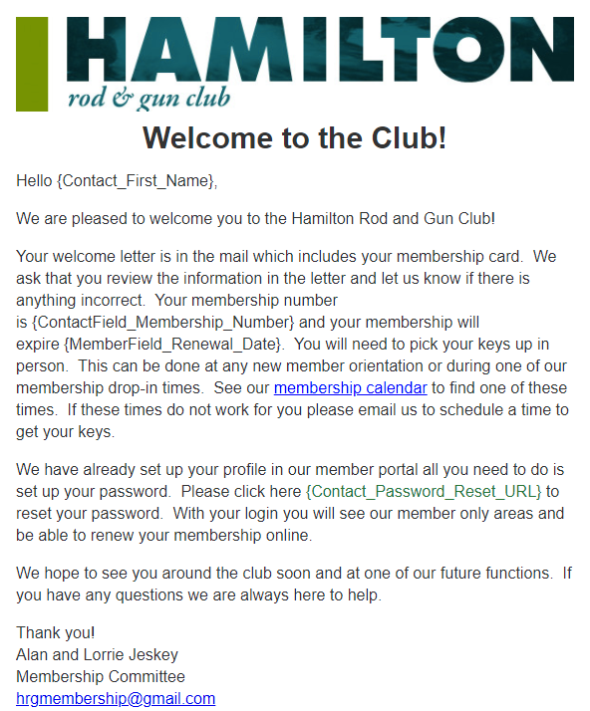
Welcome Email

Slide 4
Hours of Operations (Page 3)
Unlighted Ranges Rifle Range | Lighted Ranges Pistol and Trap
Monday – Saturday | Monday – Saturday
8:00 a.m. to Sunset | 8:00 a.m. to 10:00 p.m.
Sundays
9:30 a.m. To 4:00 p.m. Or Sunset
Whichever Is Earliest.

Slide 5
About The Club
Founded in 1921 with first meetings were held at the Dispensary Building of the Hamilton Woolen Co.
Present property was purchased in 1939 from the Snell Estate and meetings have been held in our Club House since 1947.
To the original property purchased in 1939, approximately 46 acres have been added.
Today the Club covers almost 175 acres.
The club is constantly adapting to the needs of our members.
Through our affiliation with the Worcester County League of Sportsman's Clubs we are continuously on the watch for legislation beneficial to sportsmen, as well as legislation that would be detrimental to our sport.

Slide 6
Club Management (Page 7)
Executive Officers
President | Kevin Soucie
Vice President | Don Taft
Treasurer | Kathy Soucie
Secretary | Josh Lillie
Board of Directors
Term expires 2023
Sandro “Sam” DiDonato | Larry Labonte
Lenny Senecal | Jeff Smith
Term expires 2024
Michael Blanchard | Daniel Krasnecky
Steve McNamara | Gary Sanborn
Term expires 2025
Bert Berthiaume | Alan Jeskey
Drew Nieuwenhoff | Joe Pastier

Slide 7
Committees

Slide 8
Archery (Page 8)
Outdoor range year-round thought the back part of the grounds
Indoor range within the pavilion during the winter months
Multiple seasons throughout the year (spot, winter, 3D, kids instructional)
Host to the Rinehart 3D Archery shoot for many years. 601 archers in 2017, just under 600 archers in 2018, 700 archers in 2019, 520 archers in 2021

Slide 9
Bar/Kitchen (Page 9)
Open Friday nights at 6:00 p.m. with food being served
Fish Fry Fridays during lent
Bar may close early is no customers
Children are welcome

Slide 10
Camping (Page 10)
Overlooks 3rd Pond
Season runs May 1st to last weekend in September
2022 Rates:
Seasonal $250.⁰⁰ (includes $ 100.⁰⁰ refundable cleanup deposit)
Weekly $ 50.⁰⁰
3-Day $ 25.⁰⁰
All RV’s must be registered
Dogs are allowed and must have be current on shots and be registered

Slide 11
Fishing (Page 11)
3 very accessible ponds of various sizes
First pond:
Barbless hooks only
Catch and release ice out to Father’s Day
Ice Out to Mother’s Day – fly fishing only
Mother’s Day to Father’s Day – spin fishing only
After Father’s Day – any type of fishing, can keep two (2) trout per week
Available for ice fishing at the conclusion of the ice race season
Fish shack has propane generator available for use

Slide 12
Maintenance/Grounds (Page 12)
Hold regular work parties the 2nd and 4th Saturdays of each month (excluding January and February)
Coffee/donuts at 8:30 a.m.; Work starts at 9:00 a.m. and ends about noon. Lunch of some kind is severed

Slide 13
Membership (Page 12)
Administers the club website/member portal
Send email summaries of volunteer hours
Answer questions or direct to those who can get you the answers

Slide 14
Pistol (Page 13)
Building recently renovated
New chairman and new ideas, more to come!

Slide 15
Rentals (Page 14)
Clubhouse holds up to 98 and is open year long
Pavilion holds up to 200 and is open May 1st to October 1st
Fees:
Clubhouse $200.⁰⁰; Pavilion $400.⁰⁰ plus tax
Refundable $100.⁰⁰ cleaning deposit is required
Fee does not include gratuities to TIPS certified bartender provided by the club (required for all functions)
“Member Rate” is available after complete ten (10) work hours

Slide 16
Rifle (Page 15)
Silhouette shoots
.22 Shoots
Training opportunities offered

Slide 17
Trap (Page 15)
Voice activated throwers keep the squads moving
Trap is open to the public
Shoots are held (unless raining):
Sundays 9:30 a.m. to 12:30 p.m.
2nd and 4th Friday nights each month at 6:30 p.m.
Mondays by contacting Bert

Slide 18
Upland Bird Club (UBC) (Page 16)
HRGC is an approved state licensed class B Commercial Preserve
Raise and stock our own birds
Limited membership, requiring dues
Contact ubchamilton@gmail.com to see if space available or to be added to waiting list
Fall 2019 hosted a Youth Pheasant Hunt and All Club Hunt
Paid hunts available at $20.⁰⁰/bird

Slide 19
Wounded Warriors
Hosts Wounded Warrior Appreciation Day
Warriors and guest get to try:
Archery
Pistol
Rifle
Fishing
Pheasant hunting
Breakfast and lunch provided
Raffles/door prizes

Slide 20
Youth and Entertainment (Page 17)
Kids Christmas Party
Adults Christmas Party
Movie Night
Easter Egg Hunt
Cupcake Wars
Paint and Sip Night
Trunk or Treat and Haunted House
Wreath Decorating Night

Slide 21
Additional Information

Slide 22
Volunteerism (Page 18)
New members are required to complete 10 hours, 4 during a major event (indicated by *)
A quarterly reminder of hours worked will be emailed
Be sure to sign in at each event! Look for green clipboard with green sign in sheet.
Opportunities include:
Reinhart 3D shoot ~ June
Milltown Hot Rodz Show* ~ August
Italian Motorcycle Club (IMOC)* ~ September
Maintenance Work Parties
Others as emailed

Slide 23
Upcoming Calendar of Events
August 26th ~ Outdoor Game Day
September 10th ~ IMOC
October 28th ~ Wounded Warrior Day
November 18th ~ Wreath Decorating Event
December 17th ~ Breakfast with Santa
December 30th ~ Adult Holiday Party
2024
April 13th ~ Fishing Derby
May 11th ~ Archery Banquet
June 18th ~ Wounded Warrior Fund Raiser 5:00 p.m. – 11:00 p.m.
*Volunteer Opportunity

Slide 24
Other Information
Club Access
Code opens all gates, fish shack & generator
Key Card
Will open clubhouse green door for bathroom use
Will open Pistol House for those with valid MA LTC and have completed range safety certification
Must be picked up in person, see membership calendar (https://hamiltonrg.org/Membership) for Membership Drop-In times
Apparel
T-Shirts
Hats
Fleece Jackets
Polo Shirts
Sweatshirts
And more….
Contact Kevin Soucie

Slide 25
Membership Next Steps
Board of Directors (BOD) Review/Approval ~ August 30, 2023
Once the orientation is complete the BOD will review the application and vote to approve. BOD meetings are held on the last Wednesday of the month.
General Membership (GM) Review/Approval ~ September 6, 2023
Once approved by the BOD, the application will be brought before the GM for approval. GM meetings are held the first Wednesday of the month. Approved applicants will receive their keys and membership card(s) at this meeting. Please plan to attend this meeting, it starts at 7:00 p.m.
Renewal Process ~ September 2024
Memberships will expire one (1) year from General Membership approval. Renewal letters will be mailed out and renewals can be paid online via club website (https://hamiltonrg.org). Renewal email is also sent.

Slide 26
Membership Classes
Adult ~ Person who is between the age of eighteen (18) and sixty-four (64) at the time of application for, or renewal of membership.
Senior Adult ~ Available to those persons sixty-five (65) years of age or older
Family ~ Two (2) Adults (between the age of eighteen (18) and sixty-four (64)), and all Children under the age eighteen (18), within that household at the time of application for, or renewal of membership.
Senior Family ~ Two (2) Adults, one (1) of whom is sixty-five (65) or older and all Children under the age eighteen (18) within that household.
*All ages are at the time of application or renewal of membership.

Slide 27
Fee Schedule
Class | Membership Rate* | With Initiation Fee ($50.⁰⁰)
Adult | $120.⁰⁰ | $170.⁰⁰
Family | $150.⁰⁰ | $200.⁰⁰
Senior Adult | $80.⁰⁰ | $130.⁰⁰
Senior Family | $100.⁰⁰ | $150.⁰⁰
Membership expires one (1) year from GM approval
Accepted forms of payments: cash, check, credit card
Checks accepted at orientation will be given to the club Treasurer at the Board of Directors Meeting. Please note the delay in clearing your bank.
* A $10.00 dues increase was approved at the December 2022 General Membership meeting. The rate was increased by $5.00 on January 1, 2023 and there will be a second $5.00 increase on January 1, 2024.

